Slide 1

Week 13: Classification and KNN algorithm
D R . Bisan Alsalibi
S C H O O L O F C O M P U T E R S C I E N C E S TAYLOR’S UNIVERSITY

Slide 2
Outline
Classification definition
Problem framing
Example Applications
Classification techniques
KNN classification algorithm

Slide 3


Classification Task
Assign one or more class labels to each instance of data
Used car: For each car, assign whether the car would be unacceptable, acceptable, good or very good
Weather: For each day, assign whether to play tennis or not (yes or no)
 |  |  | Unacceptable
 |  |  | Acceptable
Used Car Condition?
 |  |  | Good
 |  |  | Very Good
 |  |  | Yes
Play tennis?
 |  |  | No
Notes:
Multiclass classification – Binary

Slide 4
Data: Terminologies
Instance, example, record: Each item of data with all of its info
Person, transaction, day, car, etc.
Represented as rows of a table
Attribute, field, feature, or variable: Items of information collected about each instance
Income, title, date, condition, etc.
Type can be categorical or continuous (numeric)
Represented as the columns of a table

Slide 5
Data: Magazine Sales Example
Each instance (row) is a magazine subscription
Each field or attribute (column) is data about the subscription
attribute
Client number | Client name | Date of birth | Income | Credit | Car owner | House owner | Address | Date of subscription | Magazine
23003 | Johnson | 13-04-76 | 18500 | 17800 | no | no | 1 Downing St. | 15-04-94 | car
23003 | Johnson | 13-04-76 | 18500 | 17800 | no | no | 1 Downing St. | 21-06-93 | music
23003 | Johnson | 13-04-76 | 18500 | 17800 | no | no | 1 Downing St. | 30-05-92 | comic
23009 | Clinton | 20-10-71 | 36000 | 26600 | yes | no | 2 Boulevard | NULL | comic
23013 | King | 15-08-70 | NULL | NULL | NULL | NULL | 3 High Road | 30-02-95 | sports
23003 | Johnson | 13-04-76 | 18500 | 17800 | no | no | 1 Downing St. | 20-12-94 | house
instance

Slide 6
Labeled Data
Where does labeled data come from?
Humans annotate a set of training examples (expensive)
Labeled data comes from the past where the results are known
Notes:
Where to get the data:
e.g. tweeting ( but as mentioned very expensive)
Surveying
Data collection

Slide 7
Problem Framing
Business application of the classification task: Given a new customer, predict what types of magazines the person would like. If there are magazine types that the customers like but are not currently subscribed, design a marketing campaign to target that type of magazine subscription for those customers.

Slide 8
Problem Framing
Frame the classification task
Given the attributes of a person, predict whether the person would like car magazines or not (binary classification)
class label
Age | Income | Credit | Car owner | House owner | Car magazine
20 | 18.5 | 17.8 | 0 | 0 | 1
25 | 36.0 | 26.6 | 1 | 0 | 0
Labeled Data

Slide 9
Problem Framing
Frame the classification task
Given the attributes of a person, predict one type of magazine the person would like (multiclass classification)
class label
Age | Income | Credit | Car owner | House owner | Magazine type
20 | 18.5 | 17.8 | 0 | 0 | car
25 | 36.0 | 26.6 | 1 | 0 | comic
Labeled Data

Slide 10
Example application 1
An emergency room in a hospital measures 17 variables (e.g., blood pressure, age, etc) of newly admitted patients.
A decision is needed: whether to put a new patient in an intensive-care unit.
Due to the high cost of ICU, those patients who may survive less than a month are given higher priority.
Problem: to predict high-risk patients and discriminate them from low-risk patients.

Slide 11
Example application 2
A credit card company receives thousands of applications for new cards. Each application contains information about an applicant,
age
Marital status
annual salary
outstanding debts
credit rating
etc.
Problem: to decide whether an application should be approved, or to classify applications into two categories, approved and not approved.

Slide 12
Supervised Learning or Classifications
Like human learning from past experiences.
A computer does not have “experiences”.
A computer system learns from data, which represent some “past experiences” of an application domain.
Our focus: learn a target function that can be used to predict the values of a discrete class attribute, e.g., approve or not-approved, and high-risk or low risk.
The task is commonly called: Supervised learning, classification, or inductive learning.

Slide 13
The Data and the Goal
Data: A set of data records (also called examples, instances or cases) described by
k attributes: A₁, A₂, … A_{k}.
a class: Each example is labelled with a pre-defined class.
Goal: To learn a classification model from the data that can be used to predict the classes of new (future, or test) cases/instances.

Slide 14
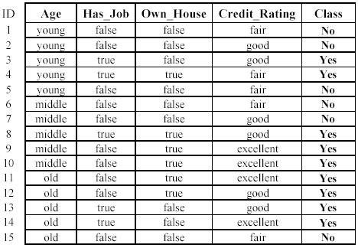
An example: data (loan application)

Slide 15
An example: the learning task
Learn a classification model from the data
Use the model to classify future loan applications into
Yes (approved) and
No (not approved)
What is the class for following case/instance?

Slide 16
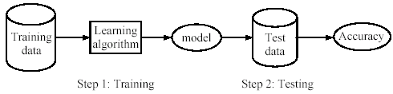
Supervised learning process: two steps
Learning (training): Learn a model using the training data
Testing: Test the model using unseen test data to assess the model accuracy

Slide 17
What do we mean by learning?
Given
a data set D,
a task T, and
a performance measure M,
a computer system is said to learn from D to perform the task T if after learning the system’s performance on T improves as measured by M.
In other words, the learned model helps the system to perform T better as compared to no learning.

Slide 18
An example
Data: Loan application data
Task: Predict whether a loan should be approved or not.
Performance measure: accuracy.
No learning: classify all future applications (test data) to the majority class (i.e., Yes):
Accuracy = 9/15 = 60%.
We can do better than 60% with learning.

Slide 19
Fundamental assumption of learning
Assumption: The distribution of training examples is identical to the distribution of test examples (including future unseen examples).
In practice, this assumption is often violated to certain degree.
Strong violations will clearly result in poor classification accuracy.
To achieve good accuracy on the test data, training examples must be sufficiently representative of the test data.

Slide 20
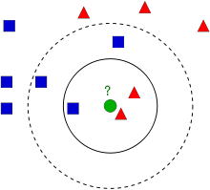
KNN: Definition
Classifies data based on their similarity with neighbors
Given a new example x, find its closest training example <x_{i}, y_{i}> and predict the class label, y

Slide 21
Nearest-Neighbor Classifiers
Requires three things
The set of stored records
Distance Metric to compute distance between records
The value of k, the number of nearest neighbors to retrieve
To classify an unknown record:
Compute distance to other training records
Identify k nearest neighbors
Use class labels of nearest neighbors to determine the class label of unknown record (e.g., by taking majority vote)

Slide 22
Definition of Nearest Neighbor
K-nearest neighbors of a record x are data points that have the k smallest distance to x
Notes:
Choose an odd k value for a 2 class problem

Slide 23
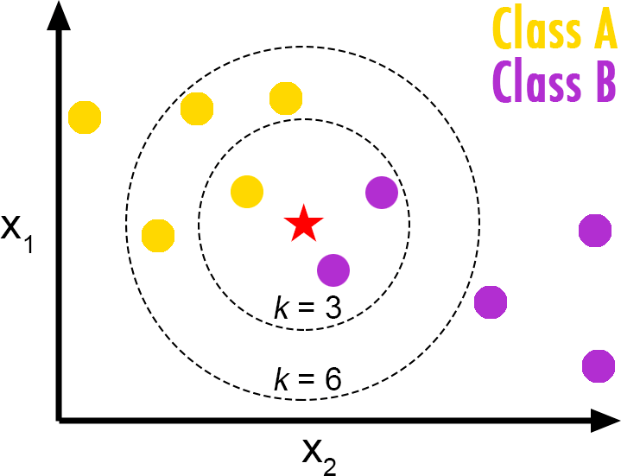
KNN: Definition
“K” stands for number of data points that are considered for the classification
To classify a new input vector x, examine the k-closest training data points to x and assign the object to the most frequently occurring class (predicted class based on majority voting)
Common values for k: 3, 5, 7, …

Slide 24
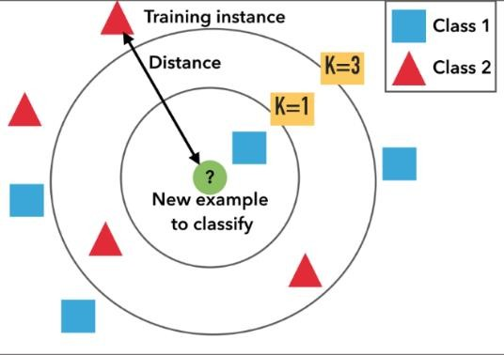
How It Works
Step 1: Calculate distance between the new data point and all the training data points
Step 2: Pick k training data points closest to the new data point
Step 3: Calculate average or majority voting to guess label of new data

Slide 25
Distance Measures
Euclidean distance (most common)
Given two points P = (p₁, p₂,..., p_{n}) and Q = (q₁, q₂,..., q_{n})
dist(P, Q) = (𝒑_{𝟏} − 𝒒_{𝟏})^{𝟐} + (𝒑_{𝟐} − 𝒒_{𝟐})^{𝟐} + … + (𝒑_{𝒏} − 𝒒_{𝒏})^{𝟐}
Example: Given P = (-2, 2) and Q = (2, 5) Euclidean Distance = dist(P, Q)
= (−2 − 2)²+(2 − 5)²
= (−4)²+(−3)²
= 16 + 9
= 25
= 5

Slide 26
Distance Measures
Manhattan distance
Given two points P = (p₁, p₂,..., p_{n}) and Q = (q₁, q₂,..., q_{n})
dist(P, Q) = (𝒑_{𝟏} − 𝒒_{𝟏} | + |𝒑_{𝟐} − 𝒒_{𝟐}| + … + |𝒑_{𝒏} − 𝒒_{𝒏}|
Example: Given P = (1, 2) and Q = (2, 5) Manhattan Distance = dist(P, Q)
= |1 – 2| + |2 – 5|
= |-1| + |-3|
= 1 + 3
= 4

Slide 27
Class Activity
Lisa has lost gender information of one of her customers, and does not know whether to make a skirt or trousers. She is planning to throw a coin. Can you help her to make a better decision using a KNN classifier?
The customer who is missing gender information: Gender ?, Waist 28, Hip 34
Let us use K = 3 nearest neighbors.

Slide 28
Class Activity
Fill in the table to calculate KNN.
Gender | Waist (cm) | Hip (cm) | Euclidean Distance | Rank minimum distance | Belongs to the neighborhood?
Male | 28 | 32
Male | 33 | 35
Female | 27 | 33
Female | 31 | 36
Count of male neighborhood members = Count of female neighborhood members =
Class based on the majority vote, gender that gets the most votes =

Slide 29
Class Activity
Fill in the table to calculate KNN.
Gender | Waist (cm) | Hip (cm) | Euclidean Distance | Rank minimum distance | Belongs to the neighborhood? (Yes/No)
Male | 28 | 32 | 2.0 | 2 | Yes
Male | 33 | 35 | 5.1 | 4 | No
Female | 27 | 33 | 1.4 | 1 | Yes
Female | 31 | 36 | 3.6 | 3 | Yes
Count of male neighborhood members = 1 Count of female neighborhood members = 2
Class based on the majority vote, gender that gets the most votes = Female

Slide 30
Example
Age | Loan | Default
25 | $40,000 | N
35 | $60,000 | N
45 | $80,000 | N
20 | $20,000 | N
35 | $120,000 | N
52 | $18,000 | N
23 | $95,000 | Y
40 | $62,000 | Y
60 | $100,000 | Y
48 | $220,000 | Y
33 | $150,000 | Y
Given on the right is a table containing details on loan defaulters.
Question: Classify an unknown case (Age=48 and Loan=$142,000) using Euclidean distance using kNN method.
Use k =1, k =3, k =5 and k =7.

Slide 31
KNN Classification – Distance
Age | Loan | Default | Distance
25 | $40,000 | N | 102000 | Sqrt((25-48)² + (40000 – 142000) ²)
35 | $60,000 | N | 82000
45 | $80,000 | N | 62000
20 | $20,000 | N | 122000
35 | $120,000 | N | 22000
52 | $18,000 | N | 124000
23 | $95,000 | Y | 47000
40 | $62,000 | Y | 80000
60 | $100,000 | Y | 42000
48 | $220,000 | Y | 78000
33 | $150,000 | Y | 8000
48 | $142,000 | ?
Euclidean Distance

Slide 32
KNN Classification – Distance
Age | Loan | Default | Distance | Rank
25 | $40,000 | N | 102000
35 | $60,000 | N | 82000
45 | $80,000 | N | 62000 | 5
20 | $20,000 | N | 122000
35 | $120,000 | N | 22000 | 2
52 | $18,000 | N | 124000
23 | $95,000 | Y | 47000 | 4
40 | $62,000 | Y | 80000
60 | $100,000 | Y | 42000 | 3
48 | $220,000 | Y | 78000
33 | $150,000 | Y | 8000 | 1
48 | $142,000 | ?
k =1 ; default = ?
k =3 ; default = ?
k =5 ; default = ?
k =7 ; default = ?
Notes:
With K=5, there are two Default=N and three Default=Y out of five closest neighbors. We can say default status for Andrew is ‘Y’ based on the major similarity of 3 points out of 5. (I am assuming K=5 only for example purpose here, since 5 is odd number)
K-NN is also a lazy learner because it doesn’t learn a discriminative function from the training data but “memorizes” the training dataset instead.

Slide 33
Good value for k?
k should be large so that error rate is minimized but if k too large will lead to over-smoothed boundaries (neighborhood may include points from other classes)
k should be small enough so that only nearby samples are included but if k too small will lead to noisy decision (too sensitive to noise)
A good “rule of thumb“ is k = sqrt(n)
Note: n stands for the number of samples in the training dataset.

Slide 34
Remarks
Choose an odd k value for a 2 class problem
k must not be a multiple of the number of classes
The main drawback of kNN is the complexity in searching the nearest neighbors for each sample

Slide 35
Non-numeric data
Feature values are not always numbers
Example
Boolean values: Yes or no, presence or absence of an attribute
Categories: Colors, educational attainment, gender
How do these values factor into the computation of distance?

Slide 36
Dealing with non-numeric data
Boolean values => convert to 0 or 1
Applies to yes-no/presence-absence attributes
Non-binary characterizations
Use natural progression when applicable; e.g., educational attainment: GS, HS, College, MS, PHD => 1,2,3,4,5
Assign arbitrary numbers but be careful about distances; e.g., color: red, yellow, blue => 1,2,3
How about unavailable data? (0 value not always the answer)

Slide 37
Preprocessing your dataset
Dataset may need to be preprocessed to ensure more reliable data mining results
Conversion of non-numeric data to numeric data
Scaling of numeric data to reduce effects of disparate ranges
Particularly when using the Euclidean distance metric

Slide 38
Advantages
Can be applied to the data from any distribution
Data does not have to be separable with a linear boundary
Very simple and intuitive
Good classification if the number of samples is large enough

Slide 39
Disadvantages
Dependent on K value
Irrelevant or correlated features have high impact and must be eliminated
Typically cannot handle high dimensionality
Computational costs: memory and classification-time computation
Test stage is computationally expensive
No training stage (all the work is done during the test stage)
Need large number of samples for accuracy
Notes:
# KNN can’t work well with bias data, it’s very sensitive to noise.

Slide 40
k-NN Time Complexity
Suppose there are n instances and m features in the dataset
Nearest neighbor algorithm requires computing n distances
Each distance computation involves scanning through each feature value
Running time complexity is proportional to m X n

